Slide 1
Airline Passenger Satisfaction Prediction
Using Machine Learning with Random Forest
Ziyad - April 2025

Slide 2
Problem statement
Airlines collect vast amounts of data on passengers, flight details, and onboard services.
However, converting this data into actionable insights to improve customer satisfaction remains a challenge.
The goal is to develop a machine learning model that accurately predicts whether a passenger is satisfied or not based on various features.

Slide 3
introduction
The airline industry places strong emphasis on customer satisfaction.
Understanding what factors drive passenger satisfaction is crucial for improving services and retaining customers.
In this project, we use machine learning to build a predictive model for passenger satisfaction.
Our goal is to help airlines gain insights from data and make data-driven decisions to enhance customer experience.

Slide 4
Objective
Analyze Airline Passenger Data
Understand customer demographics, travel habits, and in-flight service features.
Build a Predictive Classification Model
Develop a machine learning model to classify passenger satisfaction levels.
Implement Effective Preprocessing
Apply encoding, scaling, and data cleaning using Scikit-learn Pipelines.

Slide 5
Project Overview
Goal: Predict passenger satisfaction based on flight and survey data.
Process: Data cleaning, preprocessing, EDA, modeling, and evaluation.
Model Used: Random Forest Classifier.

Slide 6
Dataset Summary
50,000 passenger records with demographic, flight, and service features.
Key Features: Age, Gender, Flight Distance, Delays, Service Ratings.
Target Variable: Satisfaction (Satisfied / Not Satisfied).

Slide 7
Data Cleaning & Preprocessing
Dropped columns with >30% missing values.
Imputed missing values: median for numeric, mode for categorical.
Removed duplicates.
Applied Label Encoding, OneHotEncoding, and StandardScaler.

Slide 8
Exploratory Data Analysis (EDA)
Visualized class distribution and feature distributions.
Used boxplots for outlier detection.
Generated heatmap for feature correlation.
KDE plots showed impact of numerical features on satisfaction.

Slide 9
Model Building
Split data into training (80%) and test (20%) sets with stratification.
Pipeline: ColumnTransformer + RandomForestClassifier (100 trees).
Used encoded and scaled features.

Slide 10
Model Evaluation
Train Accuracy: 0.98
Test Accuracy: 0.95
Precision, Recall, and F1-score reported for all classes.
Model performs well on both training and test sets.

Slide 11
Feature Importance
Plotted top contributing features using bar chart.
Most Important: Flight Distance, Class, Age, Type of Travel.
Helps understand which features drive satisfaction predictions.

Slide 12
Deployment & Next Steps
Model saved as Pickle file (model.pkl).
Next: Integrate with Flask or Streamlit for deployment.
Add customer insight dashboard for business users.
Conduct A/B testing for improvements.

Slide 13
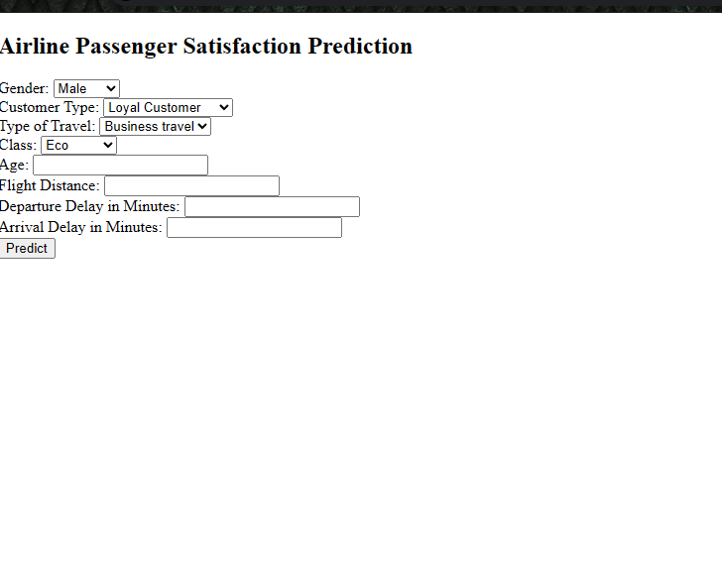

Slide 14
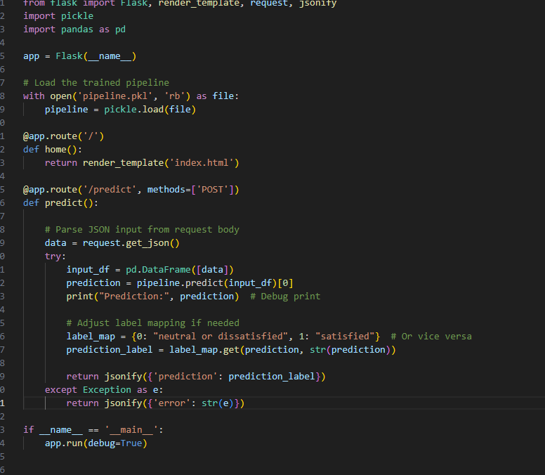

Slide 15
Thank You

